Slide 1
MotionSense: Real-Time Movement Classification Using TinyML and Smartphone Accelerometer
Team Name: The Embedded Minds
Team Leader: Varshini G S
Team Members: Swetha Mohan
Vibusha Magesh

Slide 2
Objective
To develop a lightweight, real-time motion classification system using TinyML that can accurately detect and differentiate between three types of human movement—standing, rotating, and shaking— using data from a smartphone's built-in 3-axis accelerometer.

Slide 3
Problem Statement
Traditional motion detection systems often rely on bulky hardware or cloud-based processing, which can be inefficient, costly, and slow for real-time applications.
There is a need for a compact, low-power solution that can perform accurate motion classification directly on edge devices without external dependencies.

Slide 4
Proposed Solution
Use a smartphone as the motion sensor via its built-in accelerometer.
Collect labeled motion data (stand, rotate, shake) using the Edge Impulse mobile app.
Train a TinyML model using Edge Impulse Studio to classify motion types.
The Training and testing split up is 70% and 30% respectively.
Deploy and test the model directly on the smartphone for real-time inference
Link: https://studio.edgeimpulse.com/public/781635/live

Slide 5
Analysis and Result
The trained model achieved high accuracy (100%) in classifying the three motion types.
Real-time predictions were responsive and consistent during testing.
The model was successfully deployed on-device without requiring cloud access.

Slide 6
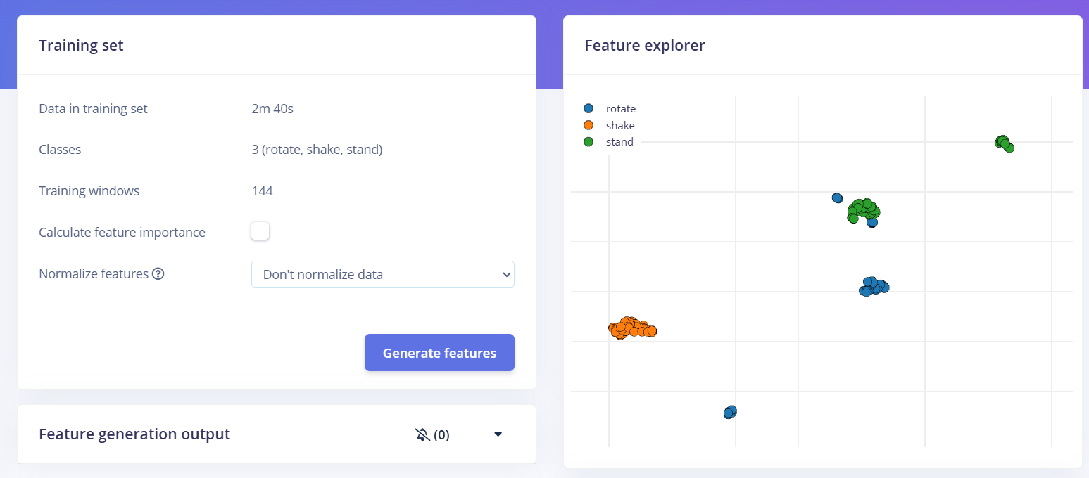

Slide 7
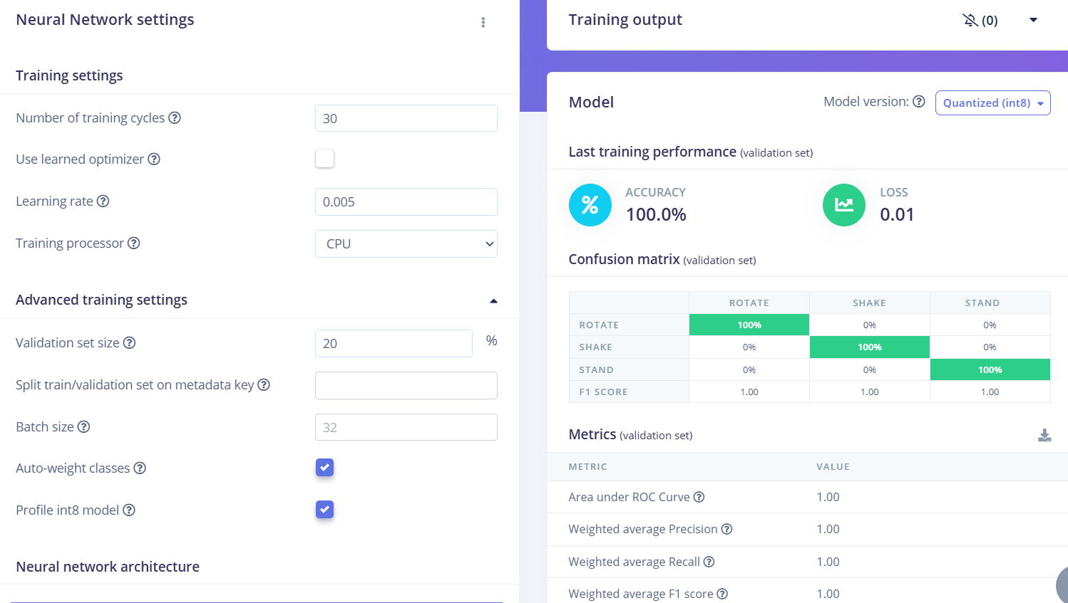

Slide 8
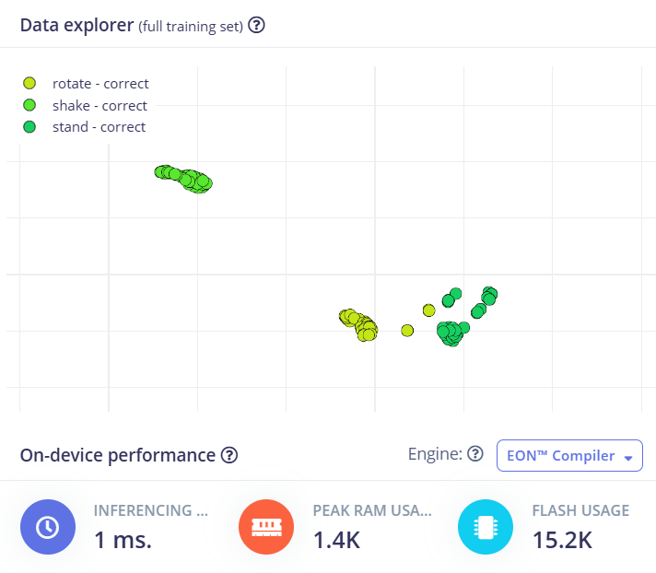

Slide 9
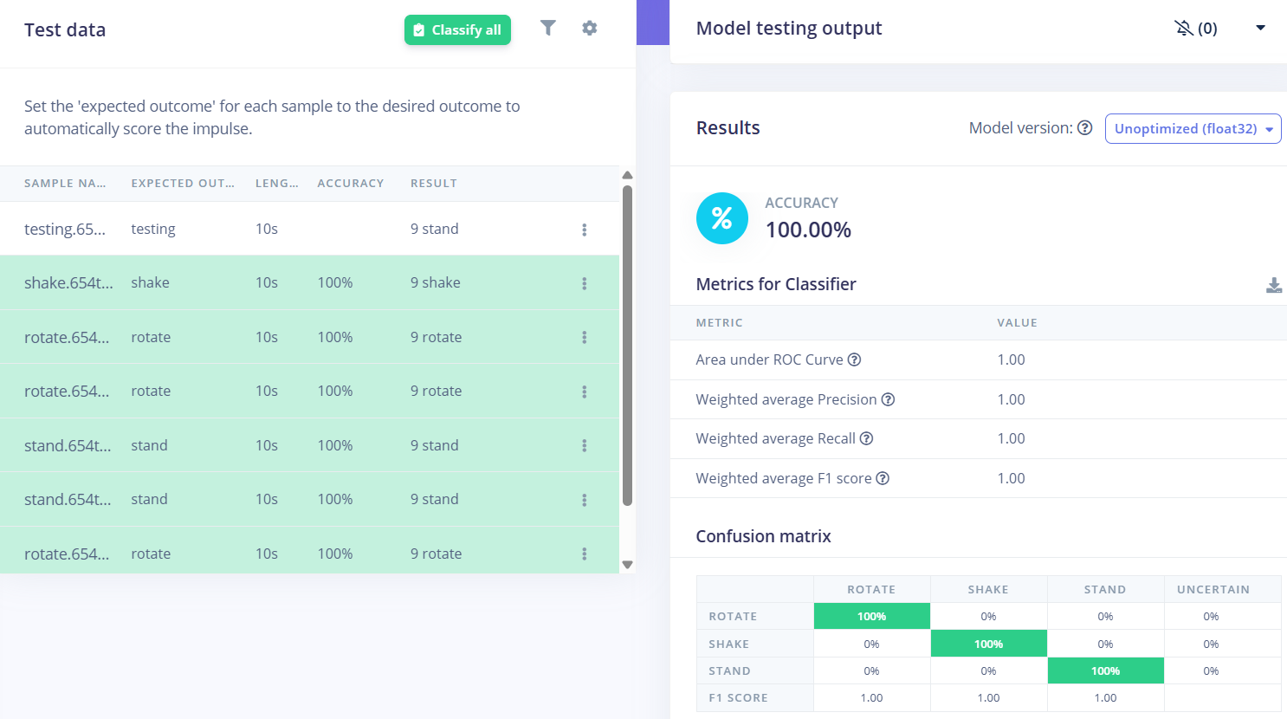

Slide 10
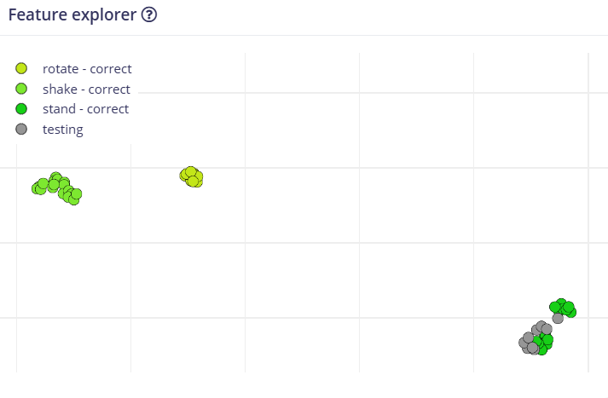

Slide 11
Advantages
No external hardware: Uses a smartphone for both sensing and inference.
Low latency: Real-time classification without cloud delays.
Energy-efficient: TinyML models consume minimal power.
Scalable: Can be extended to more motion types or deployed on wearables.
User-friendly: Edge Impulse provides an intuitive interface for data collection and model training.

Slide 12
Limitations
Limited sensor precision: Smartphone accelerometers may not match industrial-grade sensors.
Environmental noise: External vibrations or handling inconsistencies can affect accuracy.
Model generalization: May require retraining for different users or devices.
Limited motion complexity: Only basic motions (stand, rotate, shake) are considered.

Slide 13
Conclusion
This project demonstrates the power and practicality of TinyML for real-time motion classification using everyday devices. By leveraging Edge Impulse and a smartphone accelerometer, we created a compact, efficient, and accurate system for detecting basic human movements. With further refinement, this approach can be extended to more complex motion patterns and deployed in fitness tracking, gesture control, or safety monitoring applications.

Slide 14
Thank You

